Slide 1
A new kind of Faculty Meeting
Dr. Dianne Anderson

Slide 2
Most faculty meetings are boring
After a long day—the teachers sit there and listen
Or the teacher is looking at his/her phone
Or the teacher is thinking about what to take home, what has to be graded tonight
Or the teacher is thinking about what to have for supper
Wait—it doesn’t matter the teacher is not listening!

Slide 3
You have heard about flipping the classroom—what about a faculty meeting?
I would like to give some examples of ways to flip your faculty meetings so that the teacher are ready.
Surveys with kahoot
Polls with Poll Everywhere
Surveys or Questions with Plickers
A Google classroom
A One-Note Classroom

Slide 4
Kahoot
Go to Kahoot.it on your phone. It will ask for a pin and we will take a quiz together.
Now—this one was pretty easy but you can ask your faculty’s opinion on things and get immediate feedback.
To open an account—go to getkahoot.com
You could even ask questions and make sure that they read the materials that you sent to them—kinda like a test!

Slide 5
Poll Everywhere
You can send a poll to everyone and their answers can appear on the next screen.
Go to PollEverywhere.com and make an account.
Write the one question poll
Download the Poll Everywhere Add In App from pollev.com/app
After you have installed the app you will have a Poll Everywhere ribbon on top.
You will log in with the same login that you used to set up the poll
Click the Poll slide insert and you will see the slide on the next slide—It only works when you are presenting.
Let’s try it.

Slide 6
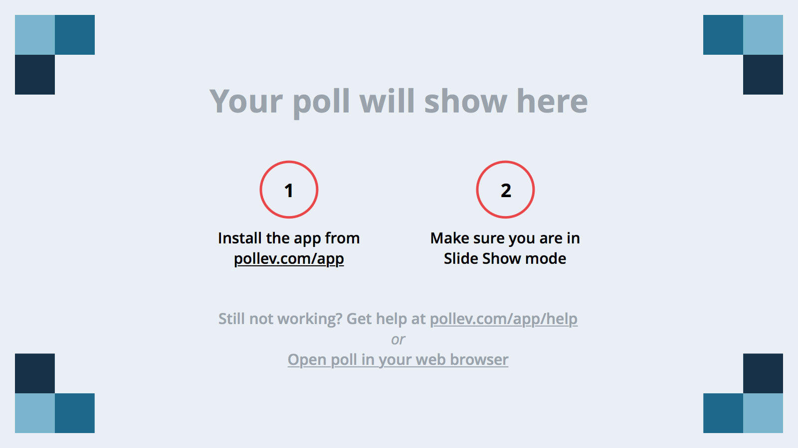
Notes:
Poll Title: What is your favorite tool that you use in your classroom or any classroom that you have been in? https://www.polleverywhere.com/free_text_polls/LTE5NjIxNzUxNTU

Slide 7
Notebooks
Do your teachers keep the information that you give out in a notebook or binder?
What if you could provide them with all that and the ability to work on it. They could keep up with Professional Development even use it for the Professionalism portion of the evaluation.
There are two examples—one from Google and one from Microsoft.

Slide 8
Google Class Notebook
Log onto your Google for School Account.
Click the boxes in the top right.
Go to classroom
You will make a classroom of your teachers. You can invite all of them using the invite buttom
Click the three lines (sometimes called hotdogs or hamburger)
You can quickly add questions, assignments, or announcement by clicking the big + sign in the bottom on the stream page.
You would be able to send all your handouts, questions, agendas, etc. before the meeting so that the meeting should be faster.

Slide 9
One Note Staff Notebook
Go to your Office 365 Email and click on the boxes in the top left corner.
Click on Staff Notebook. If it is not there, contact your TC and have them add it.
I added Faculty meetings to the list of Private Spaces
http://tinyurl.com/hjt5kbw
<iframe allowfullscreen width="95%" height="450" src="http://www.onenoteforteachers.com:80/en-US/Guides/Collaborating with the OneNote Staff Notebook for Education" frameborder="0" scrolling="no"/></iframe>

